Slide 1
CS 152 Computer Architecture and Engineering CS252 Graduate Computer Architecture Lecture 23 I/O & Warehouse-Scale Computing
Krste Asanovic
Electrical Engineering and Computer Sciences
University of California at Berkeley
http://www.eecs.berkeley.edu/~krste
http://inst.eecs.berkeley.edu/~cs152

Slide 2
Last Time in Lecture 22
Virtual machines date back to sharing mainframes for OS development
Two main types of virtual machine:
User-level, runs a single application
OS-level, emulates a whole machine for an OS
ABI – application binary interface
How an application is encoded in a file – ISA + system calls
Emulating ISAs
Software interpreter
Ahead-of-time binary translation
Dynamic translation
Hardware emulation
Hypervisors
Type-1 present separate machines to guest OS (e.g., Xen)
Type-2 built as recursive virtual machine within OS (e.g., KVM)
Increasing hardware support for virtualization
Some ISAs (including x86) not designed with virtualization in mind

Slide 3
I/O (Input/Output)
Computers useless without I/O
Over time, literally thousands of forms of computer I/O: punch cards to brain interfaces
Broad categories:
Secondary/Tertiary storage (flash/disk/tape)
Network (Ethernet, WiFi, Bluetooth, LTE)
Human-machine interfaces (keyboard, mouse, touchscreen, graphics, audio, video, neural,…)
Printers (line, laser, inkjet, photo, 3D, …)
Sensors (process control, GPS, heartrate, …)
Actuators (valves, robots, car, …)
Mix of I/O devices is highly application-dependent

Slide 4
Interfacing to I/O Devices
Two general strategies:
Memory-mapped
I/O devices appear as memory locations to processor
Reads and writes to I/O device locations configure I/O and transfer data (using either programmed I/O or DMA)
I/O channels
Architecture specifies commands to execute I/O commands over defined channels
I/O channel structure can be layered over memory-mapped device structure
In addition to data transfer, need synchronization method
Polling: CPU checks status bits
Interrupts: Device interrupts CPU on event

Slide 5
Memory-Mapped I/O
Programmed I/O uses CPU to control I/O device using load and store instructions, with address specifying device register to access
Load and store can have side effect on device, e.g., writing a byte causes that byte to be output over a serial-port interface
Usually, only privileged code can access I/O devices directly, to provide secure multiprogramming
System calls sometimes provided for application to open and reserve a device for exclusive access
Processors provide “uncached” loads and stores to prevent caching of device registers
Usually by statically assigning portions of the physical address space as uncached, or by using configuration bits in page table entries (if system has virtual memory support)

Slide 6
Simple I/O Bus Structure
CPU
Caches
Memory Bus
I/O Bus Bridge
I/O Bus
DRAM
I/O Device #1
I/O Device #2
I/O Device #3
Some range of physical addresses map to I/O bus devices
I/O bridge reduces electrical loading on critical CPU-DRAM bus
Devices can be “initiators”, initiating I/O bus transfers
Devices can be “responders”, only responding to I/O bus transactions begun by initiators

Slide 7
DMA (Direct Memory Access)
CPU
Caches
DMA
Memory Bus
I/O Bus Bridge
I/O Bus
DMA
DRAM
I/O Device #1
I/O Device #2
I/O Device #3
DMA engines offload CPU by autonomously transferring data between I/O device and main memory. CPU can poll device or be interrupted to determine when DMA is done with transaction.
DMA programmed through memory-mapped registers
Some systems use dedicated processors inside DMA engines
Often, many separate DMA engines in modern systems:
Centralized in I/O bridge (usually supporting multiple concurrent channels to different devices), works on responder-only I/O busses
Directly attached to each peripheral (if device is initiator)

Slide 8
More Complex Bus Structures
CPU
Graphics
I/O Device #1
I/O Device #2
Caches
DMA
DMA
DMA
I/O Bus Bridge
Fast I/O Bus
Memory Bus
DRAM
DMA
Slow I/O Bus
Slow I/O Bus Bridge
I/O Device #3
I/O Device #4
Match speed of I/O connection to device demands
Special direct connection for graphics
Fast I/O bus for disk drives, ethernet
Slow I/O bus for keyboard, mouse, touchscreen
Reduces load on fast I/O bus + less bus logic needed on device

Slide 9
Move from Parallel to Serial for Off-Chip I/O
CPU I/O IF
I/O 1
I/O 2
Central Bus Arbiter
Shared Parallel Bus Wires
Parallel bus clock rate limited by signal propagation across long bus (~100MHz)
High power to drive large number of loaded bus lines
Central bus arbiter adds latency to each transaction, sharing limits throughput
Expensive parallel connectors and backplanes/cables (all devices pay costs)
Examples: VMEbus, Sbus, ISA bus, PCI, SCSI, IDE
Dedicated Point-to-point Serial Links
Point-to-point links run at multi-gigabit speed using advanced clock/signal encoding (requires lots of circuitry at each end)
Lower power since only one well-behaved load
Multiple simultaneous transfers
Cheap cables and connectors (trade greater endpoint transistor cost for lower physical wiring cost), customize bandwidth per device using multiple links in parallel
Examples: Ethernet, Infiniband, PCI Express, SATA, USB, Firewire, etc.
I/O 1
CPU I/O IF
I/O 2

Slide 10
Move from Bus to Crossbar On-Chip
Busses evolved in era where wires were expensive and had to be shared
Bus tristate drivers problematic in VLSI standard cell flows, so replaced with combinational muxes
Crossbar exploits density of on-chip wiring, allows multiple simultaneous transactions
Masters
C
F
A
B
C
B
E
Slaves
D
E
F
A
D
Tristated Bus
Crossbar

Slide 11
I/O and Memory Mapping
I/O busses can be coherent or not
Non-coherent simpler, but might require flushing caches or only uncached accesses (much slower on modern processors)
Some I/O systems can cache coherently also (SGI Origin, TileLink, newer x86 systems)
I/O can use virtual addresses and an IOMMU
Simplifies DMA into user address space, otherwise contiguous user segment needs scatter/gather by DMA engine
Provides protection from bad device drivers
Adds complexity to I/O device

Slide 12
Interrupts versus Polling
Two ways to detect I/O device status:
Interrupts
No CPU overhead until event
Can happen at awkward time
Large context-switch overhead on each event (trap flushes pipeline, disturbs current working set in cache/TLB)
Polling
CPU overhead on every poll
Difficult to insert in all code
Can control when handler occurs, reduce working set hit
Hybrid approach:
Interrupt on first event, keep polling in kernel until sure no more events, then back to interrupts

Slide 13
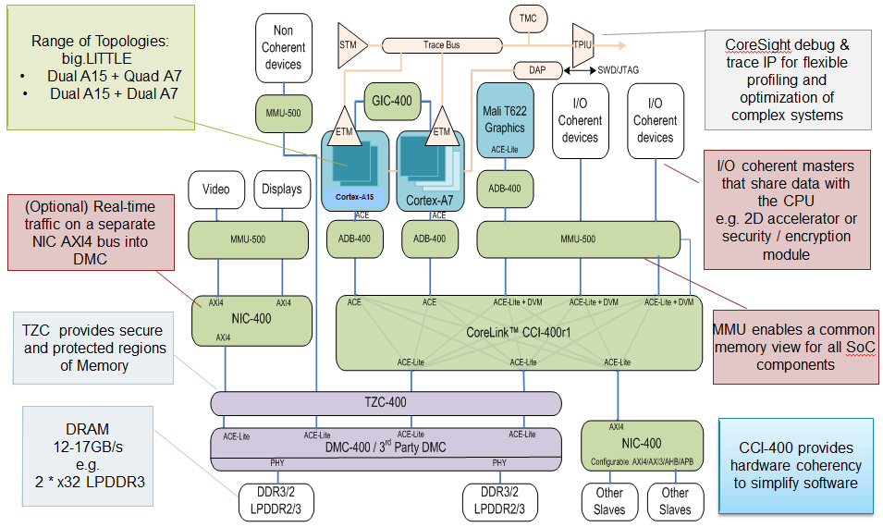
Example ARM SoC Structure
[©ARM]

Slide 14
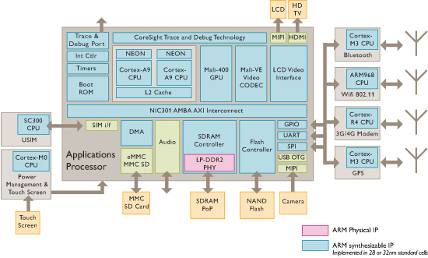
ARM Sample Smartphone Diagram
[©ARM]

Slide 15
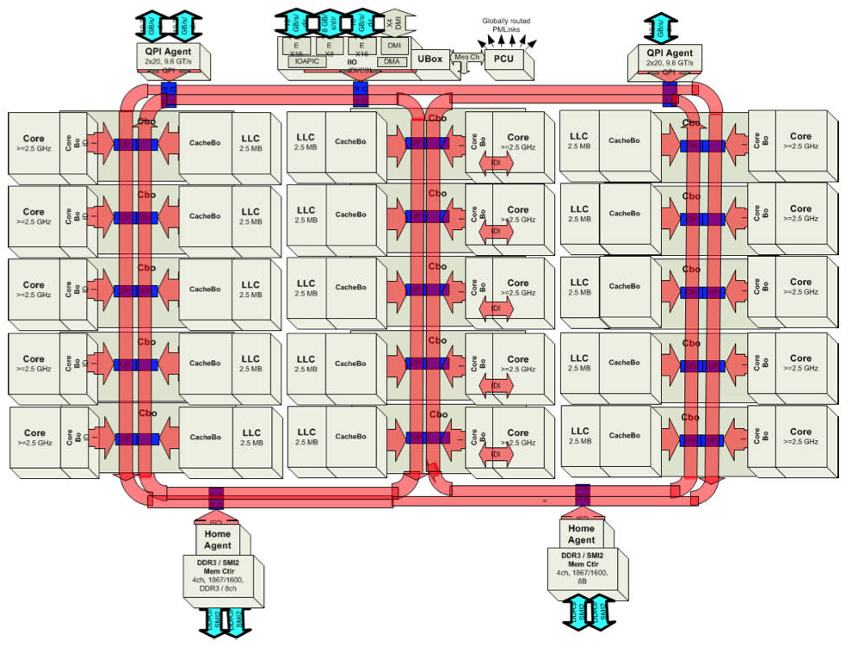
Intel Ivy Bridge Server Chip I/O
[©Intel]

Slide 16
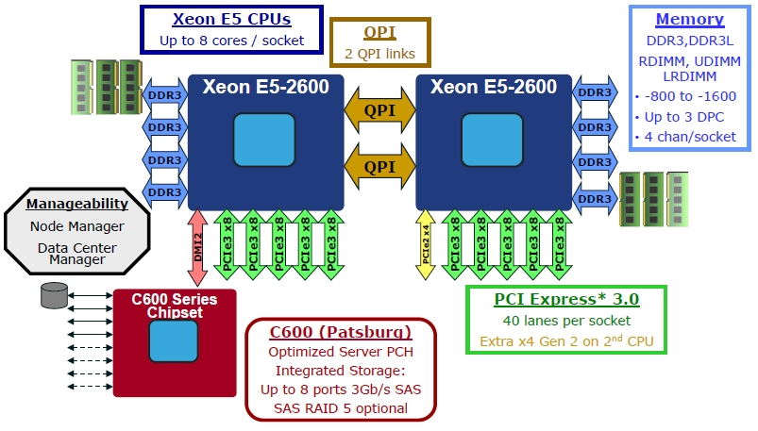
Intel Romley Server Platform
[©Intel]

Slide 17
CS152 Administrivia
Lab 5 due on May 3rd
Final Monday May 10th, 7PM-10PM
Covers entire class

Slide 18
CS252 Administrivia
Thursday April 29th Project Checkpoint
Schedule 8-minute Zoom calls during discussion period
Same schedule as last time
Please have status slides, what’s completed, what’s left to do
Final project presentations, Thursday May 6th, 4PM-6:30PM
All invited, including CS152 class
20-minute presentation, plus Q&A time
Same order as project checkpoint meetings
Final project paper due 11:59PM Friday May 14th
Send PDF file to all instructors
10-page max in conference format

Slide 19
Warehouse-scale computers (WSCs)
Introduction
Provides Internet services
Search, social networking, online maps, video sharing, online shopping, email, cloud computing, etc.
Differences with high-performance computing (HPC) “clusters”:
Clusters have higher performance processors and network
Clusters emphasize thread-level parallelism, WSCs emphasize request-level parallelism
Differences with datacenters:
Datacenters consolidate different machines and software into one location
Datacenters emphasize virtual machines and hardware heterogeneity in order to serve varied customers

Slide 20
WSC Characteristics
Introduction
Ample computational parallelism is not important
Most jobs are totally independent
“Request-level parallelism”
Operational costs count
Power consumption is a primary, not secondary, constraint when designing system
Scale and its opportunities and problems
Can afford to build customized systems since WSC require volume purchase
Location counts
Real estate, power cost; Internet, end-user, and workforce availability
Computing efficiently at low utilization
Scale and the opportunities/problems associated with scale
Unique challenges: custom hardware, failures
Unique opportunities: bulk discounts

Slide 21
Efficiency and Cost of WSC
Location of WSC
Proximity to Internet backbones, electricity cost, property tax rates, low risk from earthquakes, floods, and hurricanes
Efficiency and Cost of WSC

Slide 22
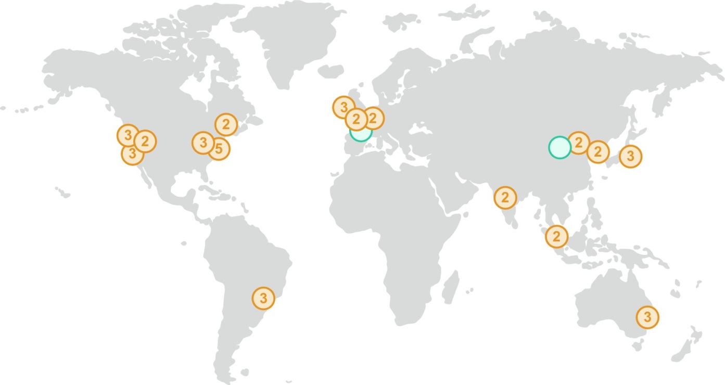
Amazon Sites
Figure 6.18 In 2017 AWS had 16 sites (“regions”), with two more opening soon. Most sites have two to three availability zones, which are located nearby but are unlikely to be affected by the same natural disaster or power outage, if one were to occur. (The number of availability zones are listed inside each circle on the map.) These 16 sites or regions collectively have 42 availability zones. Each availability zone has one or more WSCs. https://aws.amazon.com/about-aws/global-infrastructure/.

Slide 23
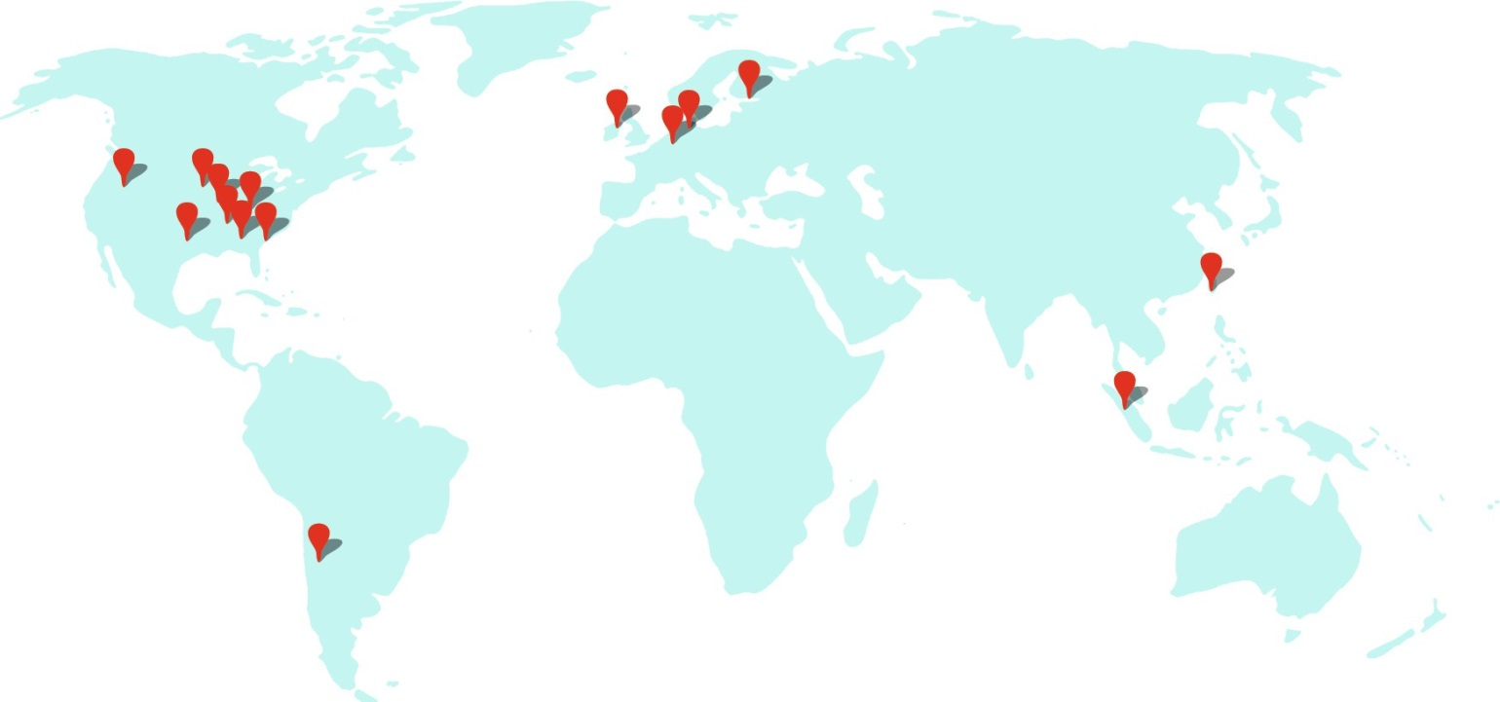
Google Sites
Figure 6.19 In 2017 Google had 15 sites. In the Americas: Berkeley County, South Carolina; Council Bluffs, Iowa; Douglas County, Georgia; Jackson County, Alabama; Lenoir, North Carolina; Mayes County, Oklahoma; Montgomery County, Tennessee; Quilicura, Chile; and The Dalles, Oregon. In Asia: Changhua County, Taiwan; Singapore. In Europe: Dublin, Ireland; Eemshaven, Netherlands; Hamina, Finland; St. Ghislain, Belgium. https://www.google.com/about/datacenters/inside/locations/.

Slide 24
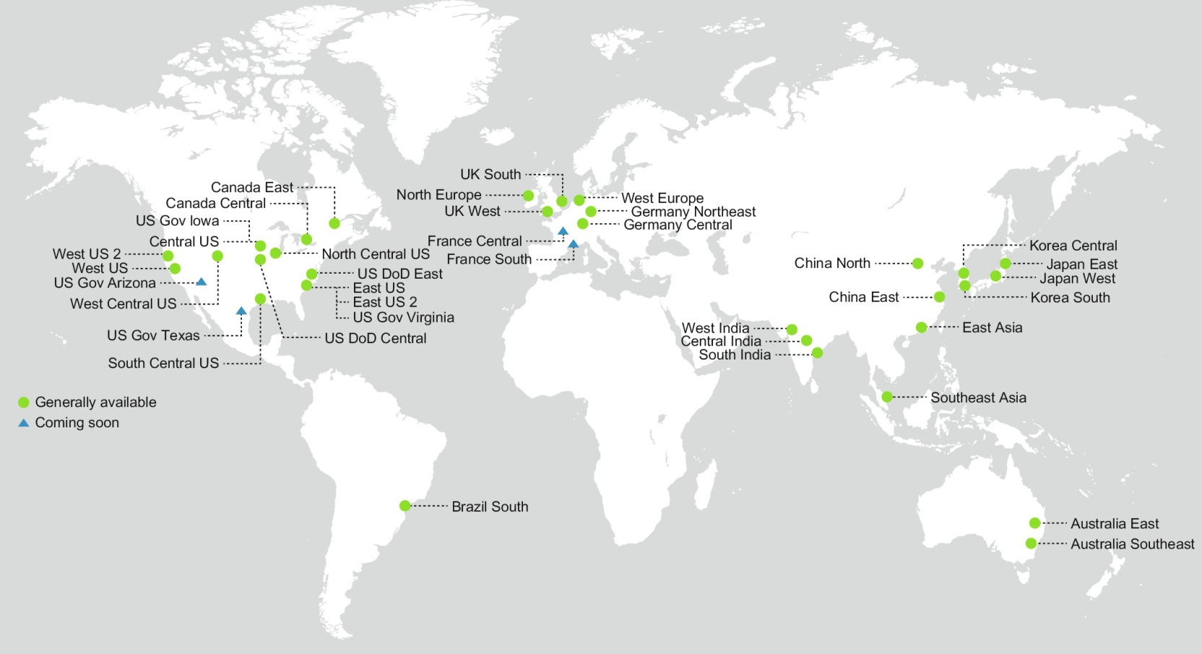
Microsoft Sites
Figure 6.20 In 2017 Microsoft had 34 sites, with four more opening soon. https://azure.microsoft.com/en-us/regions/.

Slide 25
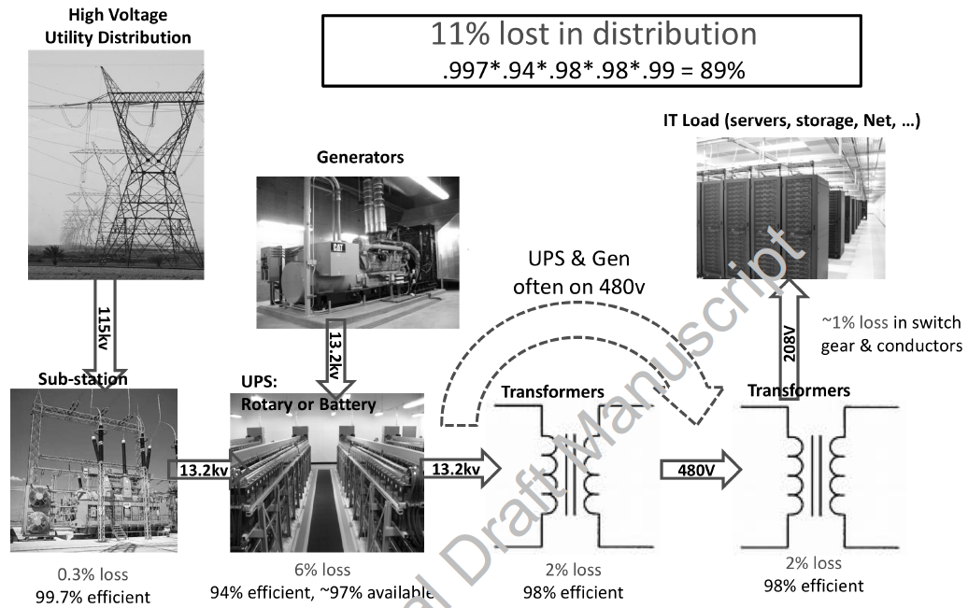
Power Distribution
Efficiency and Cost of WSC

Slide 26
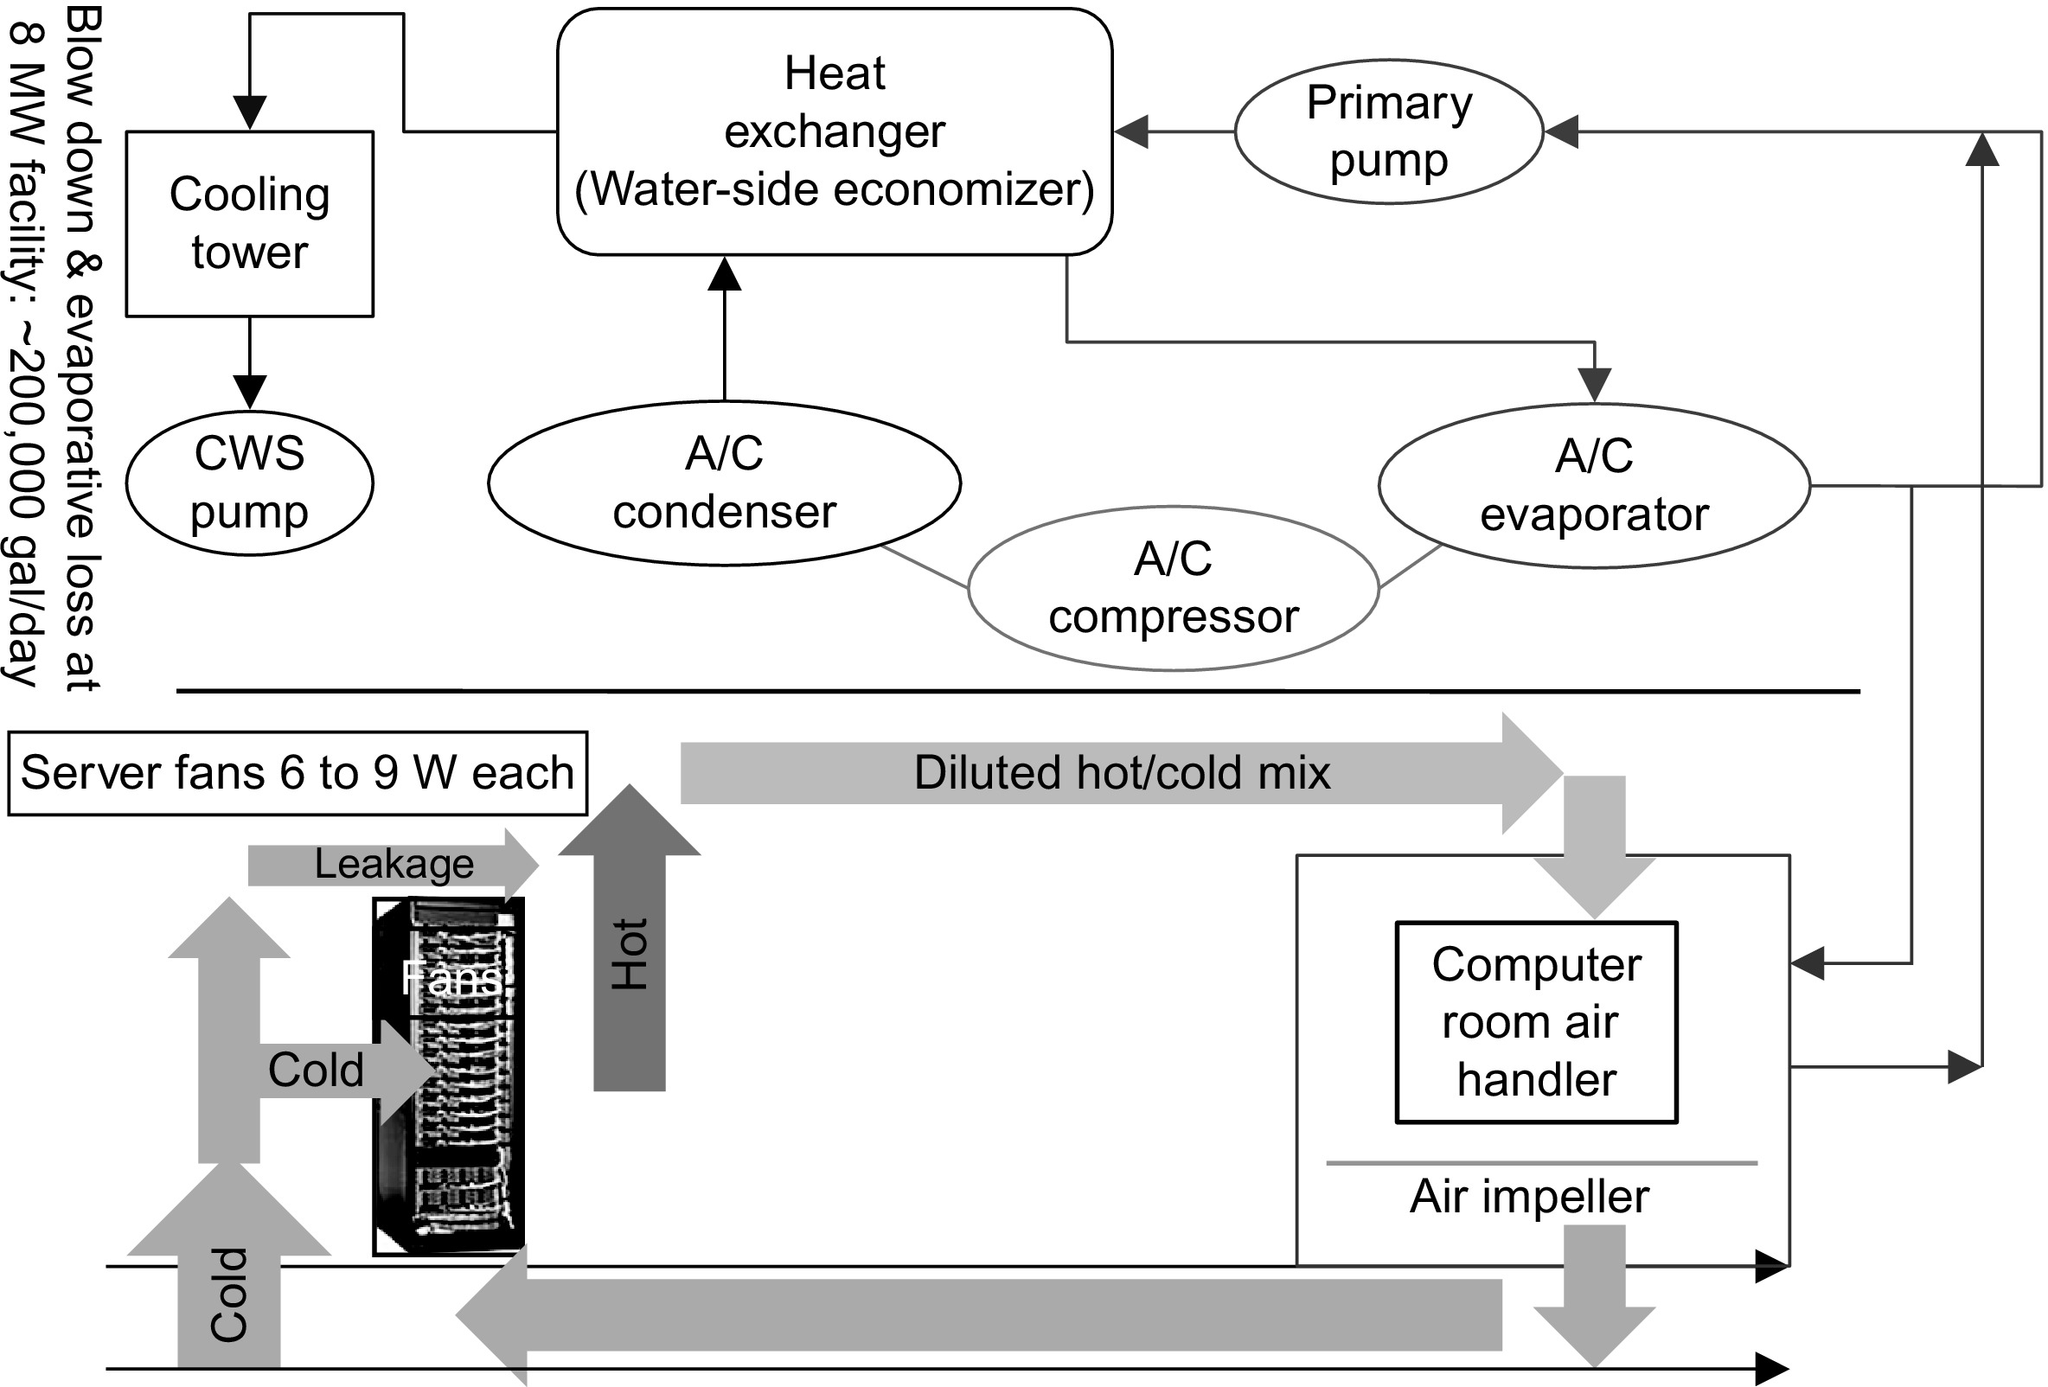
Cooling
Figure 6.9 Mechanical design for cooling systems. CWS stands for circulating water system. From Hamilton, J., 2010. Cloud computing economies of scale. In: Paper Presented at the AWS Workshop on Genomics and Cloud Computing, June 8, 2010, Seattle, WA. http://mvdirona.com/jrh/TalksAndPapers/JamesHamilton_GenomicsCloud20100608.pdf.

Slide 27
Infrastructure and Costs of WSC
Cooling system also uses water (evaporation and spills)
E.g. 70,000 to 200,000 gallons per day for an 8 MW facility
Power cost breakdown:
Chillers: 30-50% of the power used by the IT equipment
Air conditioning: 10-20% of the IT power, mostly due to fans
How many servers can a WSC support?
Each server:
“Nameplate power rating” gives maximum power consumption
To get actual, measure power under actual workloads
Oversubscribe cumulative server power by 40%, but monitor power closely
Physcical Infrastrcuture and Costs of WSC

Slide 28
Infrastructure and Costs of WSC
Determining the maximum server capacity
Nameplate power rating: maximum power that a server can draw
Better approach: measure under various workloads
Oversubscribe by 40%
Typical power usage by component:
Processors: 42%
DRAM: 12%
Disks: 14%
Networking: 5%
Cooling: 15%
Power overhead: 8%
Miscellaneous: 4%
Physcical Infrastrcuture and Costs of WSC

Slide 29
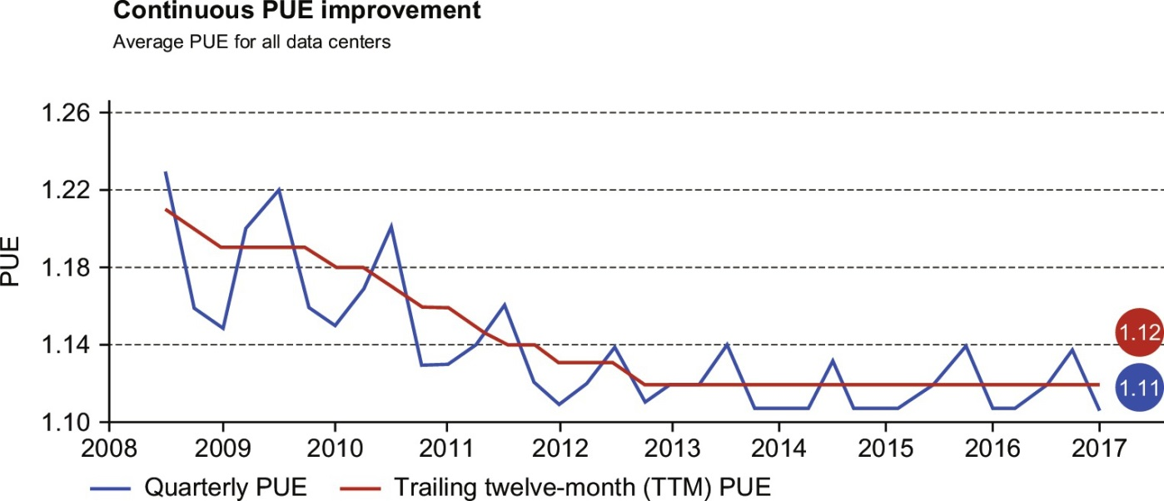
Power Utilization Effectiveness (PUE)
= Total facility power / IT equipment power
Physcical Infrastrcuture and Costs of WSC
Figure 6.11 Average power utilization efficiency (PUE) of the 15 Google WSCs between 2008 and 2017. The spiking line is the quarterly average PUE, and the straighter line is the trailing 12-month average PUE. For Q4 2016, the averages were 1.11 and 1.12, respectively.

Slide 30
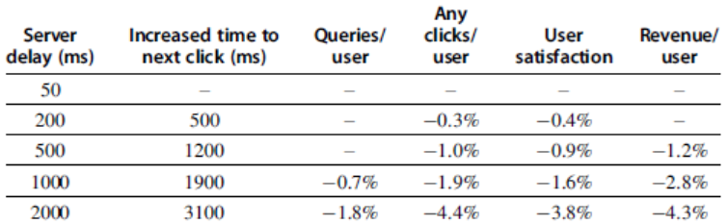
Performance, Latency
Latency is important metric because it is seen by users
Bing study: users will use search less as response time increases
Service Level Objectives (SLOs)/Service Level Agreements (SLAs)
E.g. 99% of requests be below 100 ms
Physcical Infrastrcuture and Costs of WSC

Slide 31
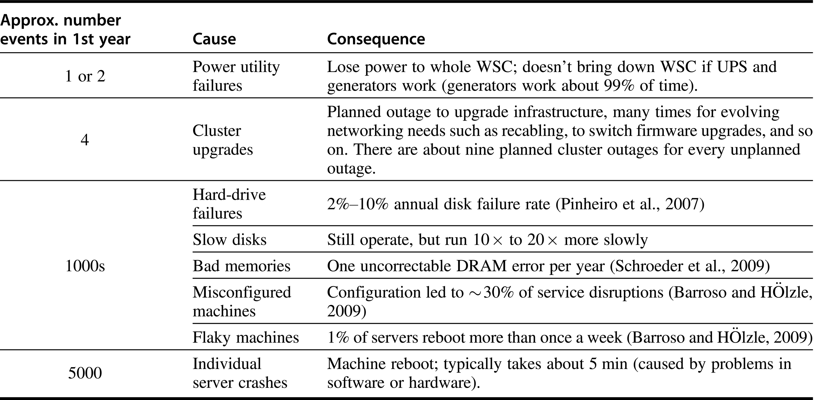
Outages and Anomalies
Figure 6.1 List of outages and anomalies with the approximate frequencies of occurrences in the first year of a new cluster of 2400 servers. We label what Google calls a cluster an array; see Figure 6.5. Based on Barroso, L.A., 2010. Warehouse Scale Computing [keynote address]. In: Proceedings of ACM SIGMOD, June 8–10, 2010, Indianapolis, IN.

Slide 32
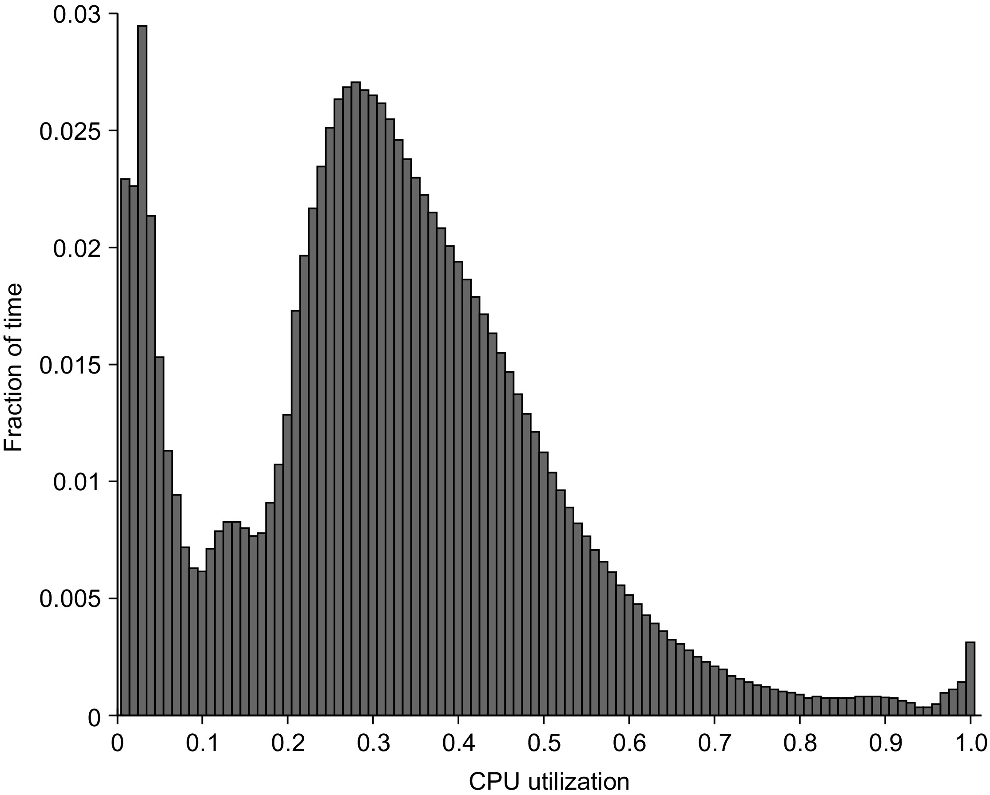
CPU Utilization is Usually Low
Figure 6.3 Average CPU utilization of more than 5000 servers during a 6-month period at Google. Servers are rarely completely idle or fully utilized, instead operating most of the time at between 10% and 50% of their maximum utilization. The third column from the right in Figure 6.4 calculates percentages plus or minus 5% to come up with the weightings; thus 1.2% for the 90% row means that 1.2% of servers were between 85% and 95% utilized.
From Figure 1 in Barroso, L.A., Hölzle, U., 2007. The case for energy-proportional computing. IEEE Comput. 40 (12), 33–37.

Slide 33
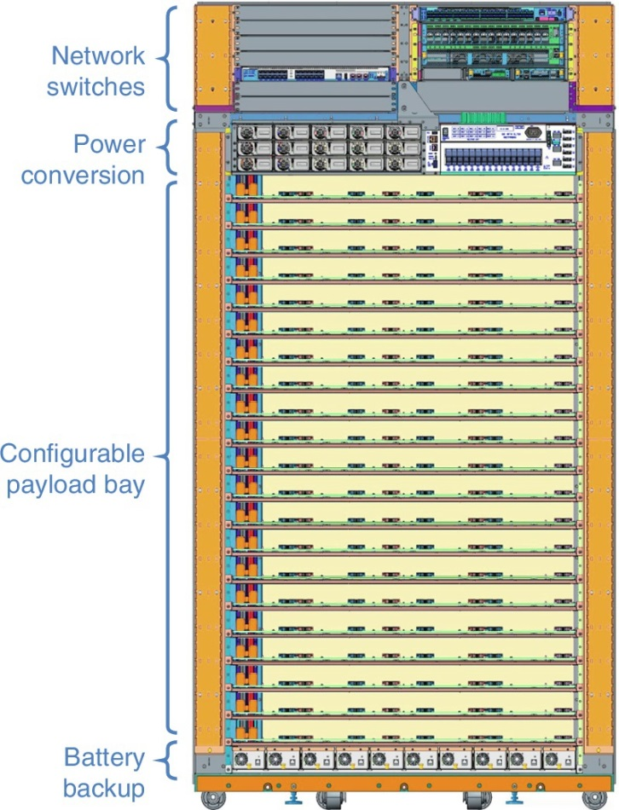
Google WSC Rack
Figure 6.30 A Google rack for its WSC. Its dimensions are about 7 ft high, 4 ft wide, and 2 ft deep (2 m × 1.2 m × 0.5 m). The Top of Rack switches are indeed at the top of this rack. Next comes the power converter that converts from 240 V AC to 48 V DC for the servers in the rack using a bus bar at the back of the rack. Next is the 20 slots (depending on the height of the server) that can be configured for the various types of servers that can be placed in the rack. Up to four servers can be placed per tray. At the bottom of the rack are high-efficiency distributed modular DC uninterruptible power supply (UPS) batteries.

Slide 34
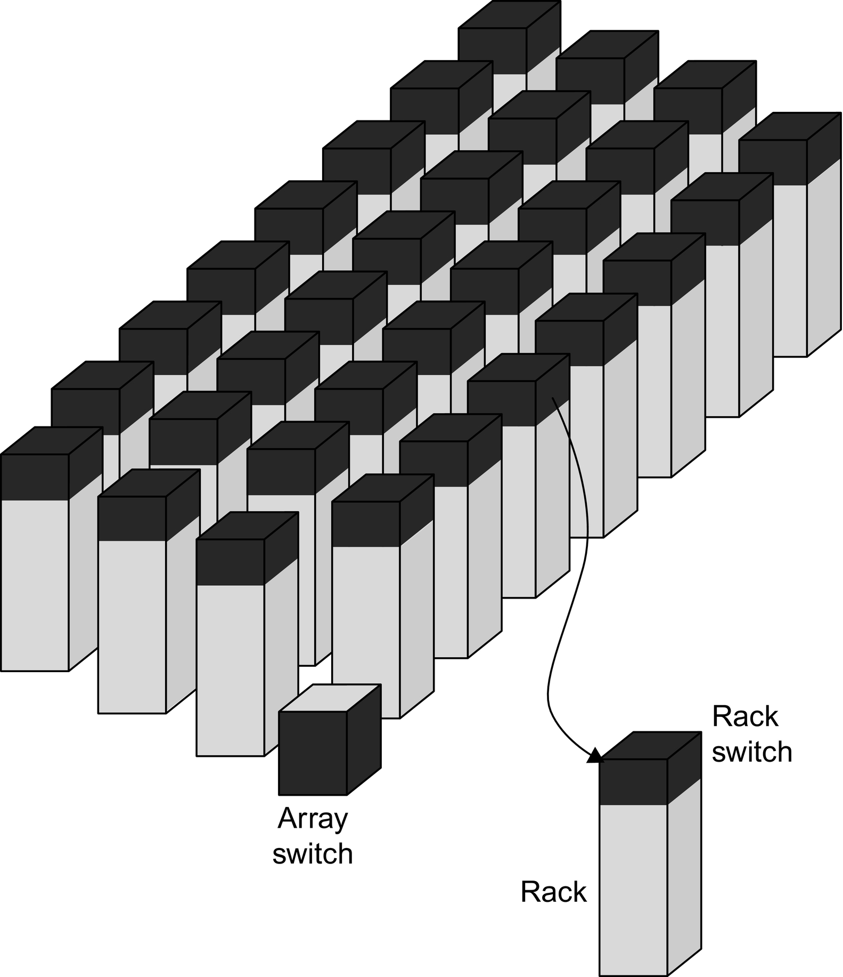
Array of Racks
Figure 6.5 Hierarchy of switches in a WSC. Based on Figure 1.1 in Barroso, L.A., Clidaras, J., Hölzle, U., 2013. The datacenter as a computer: an introduction to the design of warehouse-scale machines. Synth. Lect. Comput. Architect. 8 (3), 1–154.

Slide 35
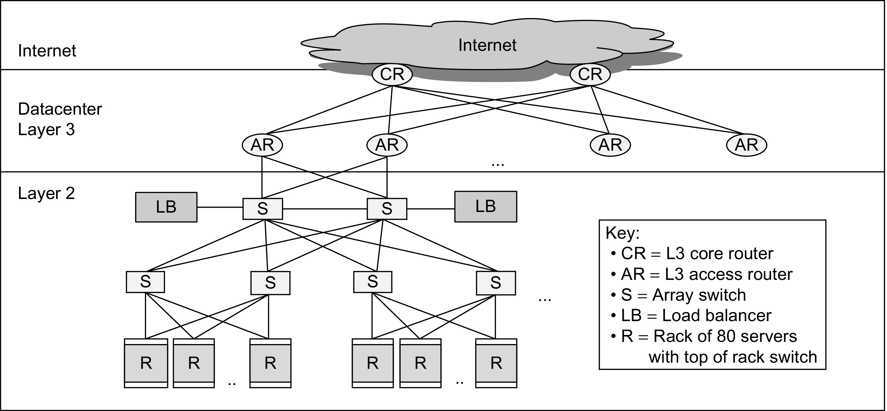
Older WSC Network Structure
Figure 6.8 A Layer 3 network used to link arrays together and to the Internet (Greenberg et al., 2009). A load balancer monitors how busy a set of servers is and directs traffic to the less loaded ones to try to keep the servers approximately equally utilized. Another option is to use a separate border router to connect the Internet to the data center Layer 3 switches. As we will see in Section 6.6, many modern WSCs have abandoned the conventional layered networking stack of traditional switches.

Slide 36
Array Switch
Switch that connects an array of racks
Array switch should have 10 X the bisection bandwidth of rack switch
Cost of n-port switch grows as n²
Often utilize content-addressable memory chips and FPGAs
Computer Ar4chitecture of WSC

Slide 37
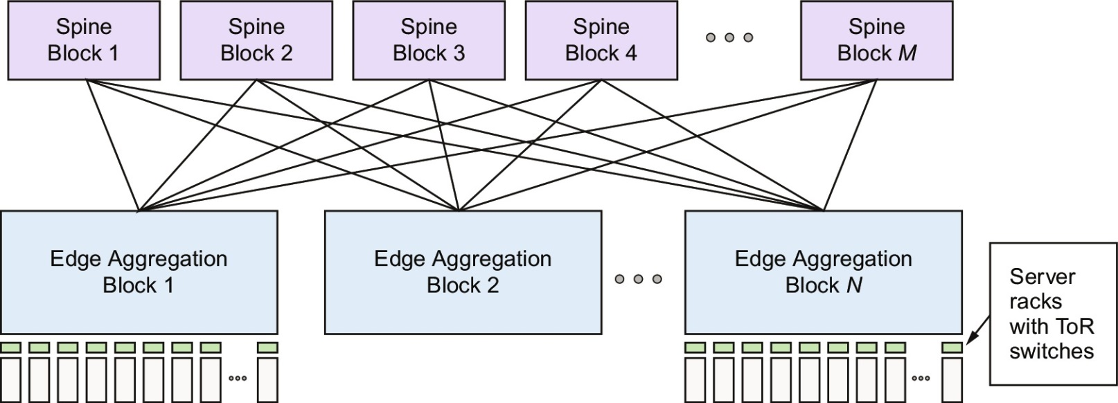
Newer Clos Network Structure
Figure 6.31 A Clos network has three logical stages containing crossbar switches: ingress, middle, and egress. Each input to the ingress stage can go through any of the middle stages to be routed to any output of the egress stage. In this figure, the middle stages are the M Spine Blocks, and the ingress and egress stages are in the N Edge Activation Blocks. Figure 6.22 shows the changes in the Spine Blocks and the Edge Aggregation Blocks over many generations of Clos networks in Google WSCs.

Slide 38
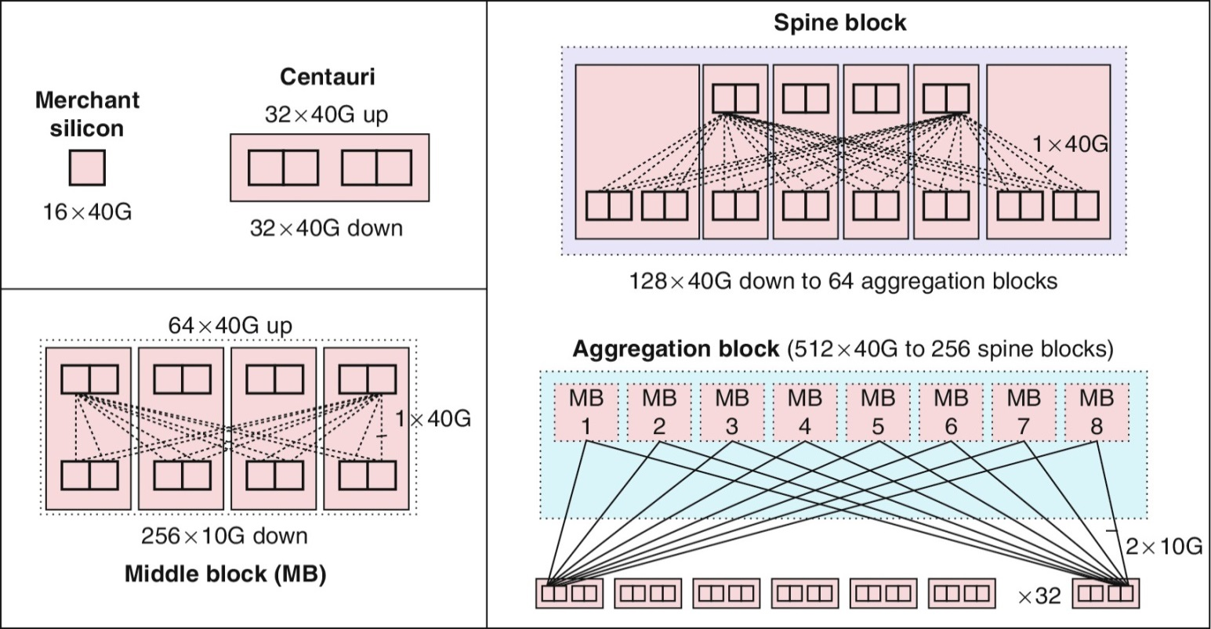
Google Jupiter Clos Network
Figure 6.32 Building blocks of the Jupiter Clos network.

Slide 39
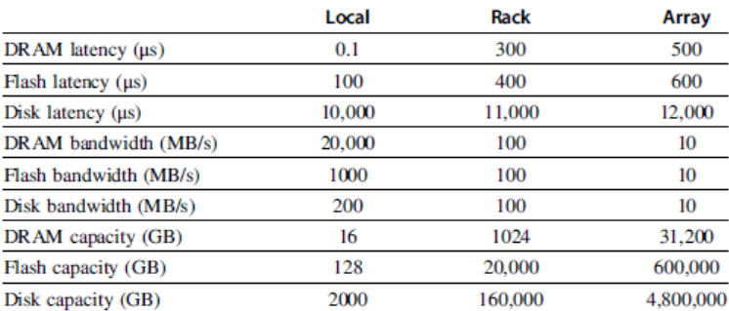
WSC Memory Hierarchy
Servers can access DRAM and disks on other servers using a NUMA-style interface
Computer Ar4chitecture of WSC

Slide 40
Storage options
Use disks inside the servers, or
Network attached storage through Infiniband
WSCs generally rely on local disks
Google File System (GFS) uses local disks and maintains at least three replicas
Computer Ar4chitecture of WSC

Slide 41
Cost of a WSC
Capital expenditures (CAPEX)
Cost to build a WSC
$9 to 13/watt
Operational expenditures (OPEX)
Cost to operate a WSC
Physcical Infrastrcuture and Costs of WSC

Slide 42
Prgrm’g Models and Workloads
Batch processing framework: MapReduce
Map: applies a programmer-supplied function to each logical input record
Runs on thousands of computers
Provides new set of key-value pairs as intermediate values
Reduce: collapses values using another programmer-supplied function
Programming Models and Workloads for WSCs

Slide 43
Prgrm’g Models and Workloads
Example:
map (String key, String value):
// key: document name
// value: document contents
for each word w in value
EmitIntermediate(w,”1”); // Produce list of all words
reduce (String key, Iterator values):
// key: a word
// value: a list of counts
int result = 0;
for each v in values:
result += ParseInt(v); // get integer from key-value pair
Emit(AsString(result));
Programming Models and Workloads for WSCs

Slide 44
Prgrm’g Models and Workloads
Availability:
Use replicas of data across different servers
Use relaxed consistency:
No need for all replicas to always agree
File systems: GFS and Colossus
Databases: Dynamo and BigTable
Programming Models and Workloads for WSCs

Slide 45
Prgrm’g Models and Workloads
MapReduce runtime environment schedules map and reduce task to WSC nodes
Workload demands often vary considerably
Scheduler assigns tasks based on completion of prior tasks
Tail latency/execution time variability: single slow task can hold up large MapReduce job
Runtime libraries replicate tasks near end of job
Don’t wait for stragglers, repeat task somewhere else
Programming Models and Workloads for WSCs

